Slide 1

Different technologies used for proteomics measurement
EPI-OMICs Journal Club
9-Feb-2023
Keyong Deng
Department of Clinical Epidemiology

Slide 2
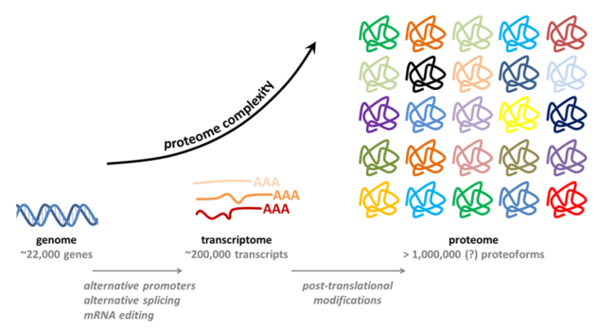
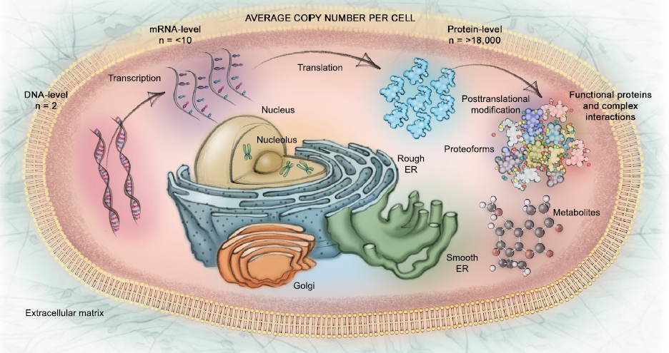
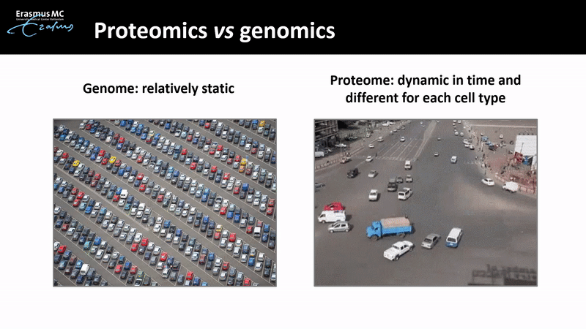
Background
Central dogma
Genome
Transcriptome
Proteome
Metabolome
…
Phenotype
~30,000 proteins make up the human proteome
Medications or lifestyle changes cause shifts in the proteome

Slide 3


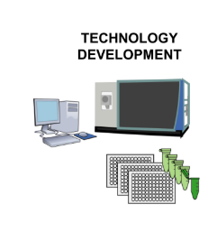
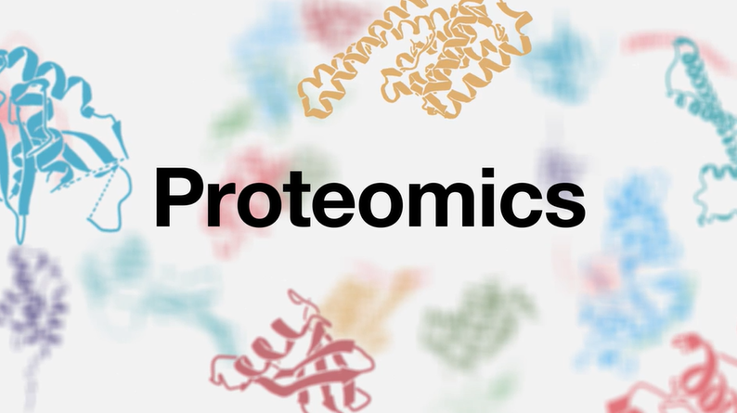
What’s Proteomics?
Proteins
Proteomics is a high throughput way to measure all proteins in a cell or tissue by using mass spectrometry or other methods
Why do we use Proteomics?
Discover potential biomarkers (also those previously unrecorded)
prostate-specific antigen (PSA) for cancer diagnosis
…
Identify druggable targets
Identify novel pathways involved in the process of disease

Slide 4
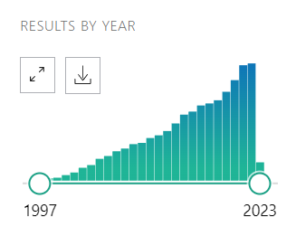
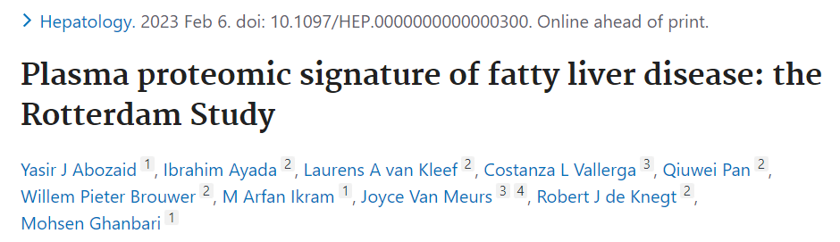
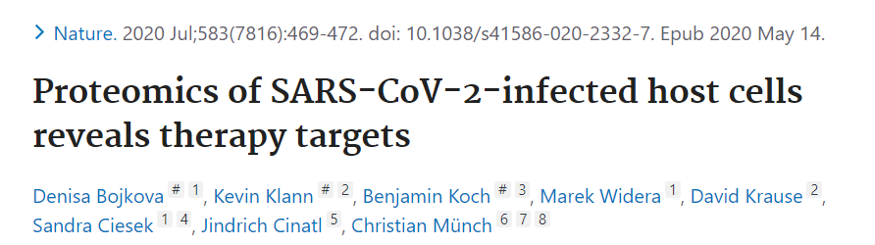

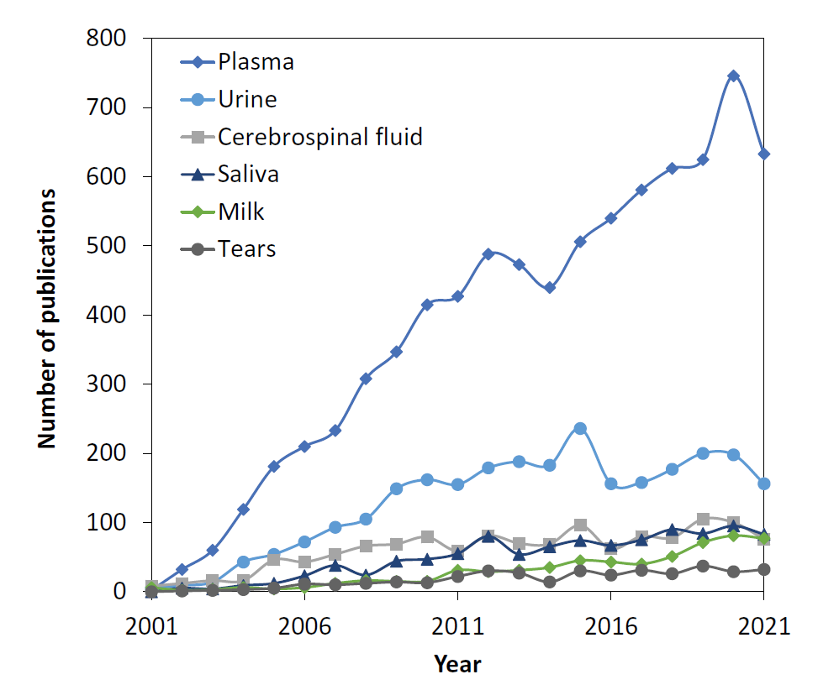
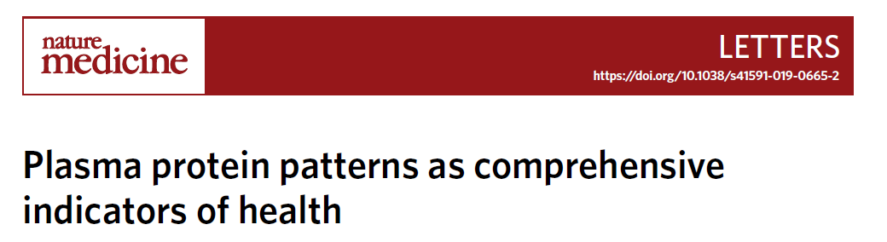
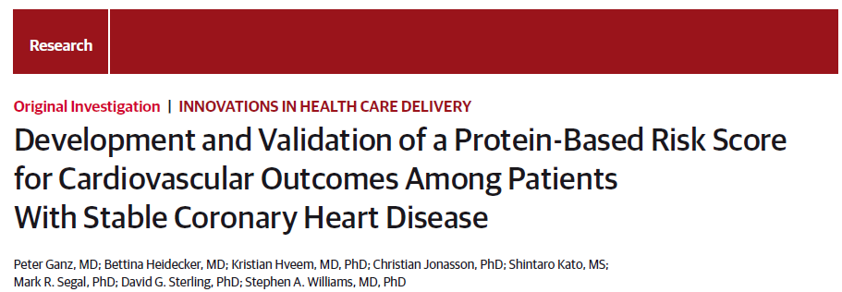

Slide 5
Technology development
Low throughput
High throughput
Western blot
Enzyme-linked immunosorbent assays (ELISA)
Immunohistochemistry
Immunofluorescence
Mass spectrometry
Aptamer-based array
Immunoaffinity array (proximity extension assay-based)

Slide 6
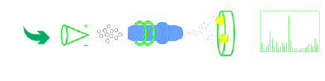
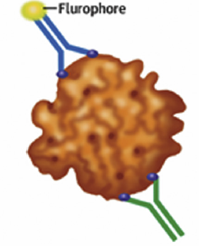
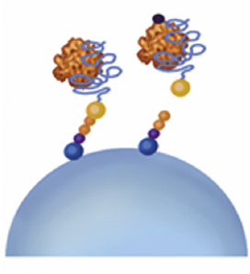
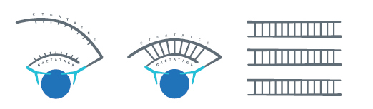
Four common proteomic technologies
Mass spectrometry (MS)-based
LC/MS-MS
Fragments proteins and measure Mass-to-charge ratios
Protein microarray
Antibodies with fluorophore
Aptamer-based
SOMA (slow off-rate modified aptamers )scan platform
Oligonucleotides increase sensitivity & specificity
Proximity extension assay (PEA)-based
OLINK platform
Paired DNA-conjugated antibodies

Slide 7
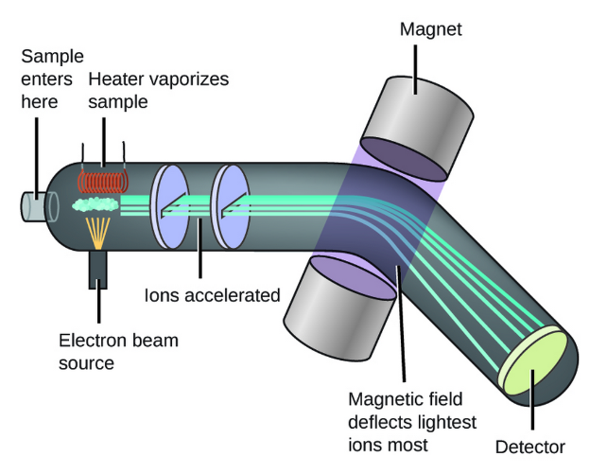
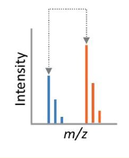
1. MS-based proteomics
MS has three basic components:
Ion source
Electrospray ionization (ESI)
Mass analyser: separate ions by their mass-to-charge ratios (m/z)
Quadrupoles, time-of-flight (TOF), Orbitrap
Detector

Slide 8
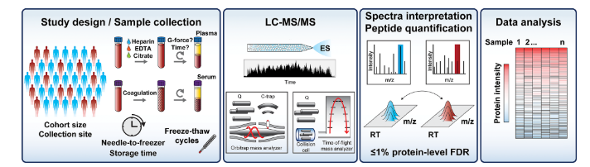
1. MS-based proteomics
Top-down strategy
Full-length protein -> problems: heterogeneity of proteins
Bottom-up strategy
Peptides (digested protein)
Coverage more than 10,000 preteins
Protein digestion -> peptide purification -> separated by Liquid chromatography ->
Ionized by electrospray (ES) -> Analysis in MS

Slide 9
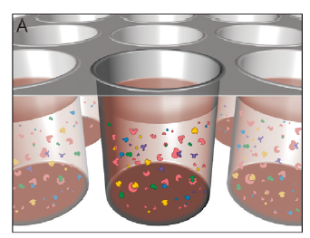
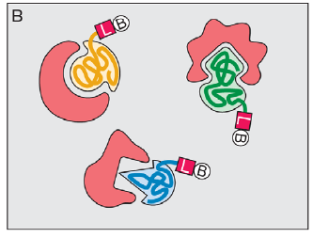
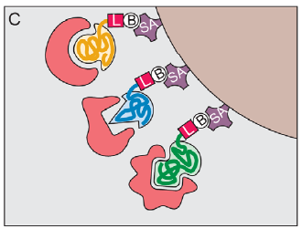
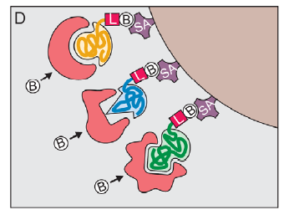
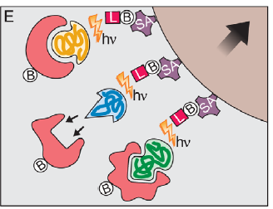
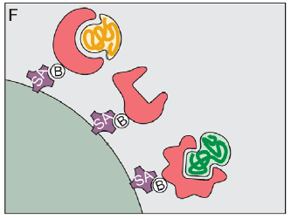
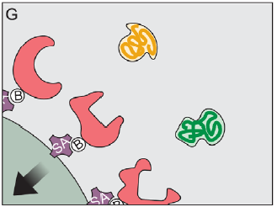
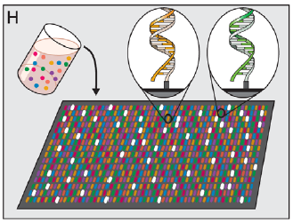
2. Aptamer-based proteomics
Aptamers are short, single-stranded oligonucleotides (DNA) that can selectively bind to a specific protein target
Binding (SOMAmers + samples)
SOMAmers contain biotin (B) and photo-cleavable linker (L) and fluorescent tag at 5’ end,
Binding with proteins
SOMAmers captured onto a bead coated with streptavidin (SA) which binds biotin
Proteins are tagged with NHS-biotin
UV light cleaves the linker and SOMAmers released
SOMAmer-protein complexes captured onto new SA coated beads by protein biotin tag
SOMAmers released from complexes into solution at high pH
Remaining SOMAmers are quantified by hybridization to microarray

Slide 10
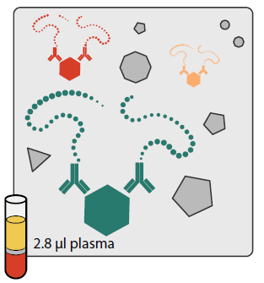
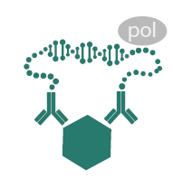
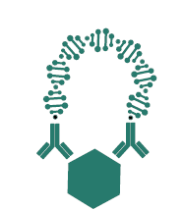
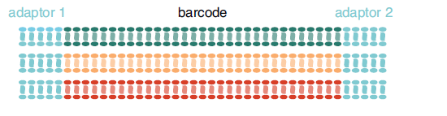
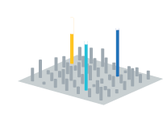
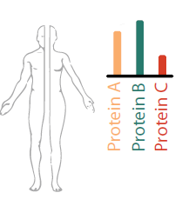
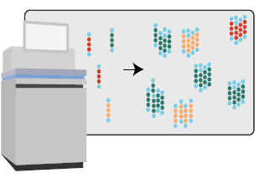
3. Proximity extension assay (PEA)-based proteomics
Using paired, nucleotide-labelled antibody probes for multiplexing of proteins at high sample throughput
DNA-conjugated antibodies bind to their target protein
Antibodies with correct matched pairs hybridize and extended by DNA polymerase
DNA tags extended & amplified
Unique barcode-regions identify each sample and protein and adaptors
Hybridized DNA strands: amplified and measured using qPCR or NGS

Slide 11

Which one should we choose?
Q: What are important factors?

Slide 12
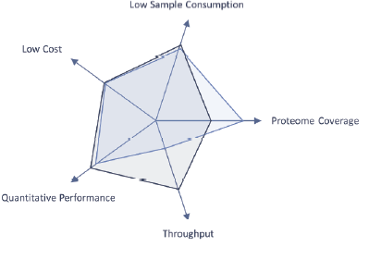
It depends on
Budgets! ($.$, always important)
Sample size or power calculation
Research question (if focus on posyttranslational modifications)
Sample consumption (if difficult to get)
Dynamic range (if huge or not)
…

Slide 13
Technical factors influence selection
 | MS | Aptamer | PEA
Sample throughput | Low (untargeted) to moderate (targeted) | High | High
Analyte multiplex | All proteins in sample: 10 to >5000 | >1300 proteins | Depends on different panels
Sample volume | 30ul (targeted) to 100s of ul | 65ul | 1ul to 100s of ul
Dynamic range | High and medium-abundance proteins | Wide (mg/mL to pg/mL) | Wide (down to fg/mL)
Reproducibility | Modest | Good | Good
Quantification | Relative, targeted labeling for absolute | Relative | Absolute or relative
Characterization of PTMs | Yes | NO | NO
Bioinformatics | Multiple software available | Easy | Easy

Slide 14
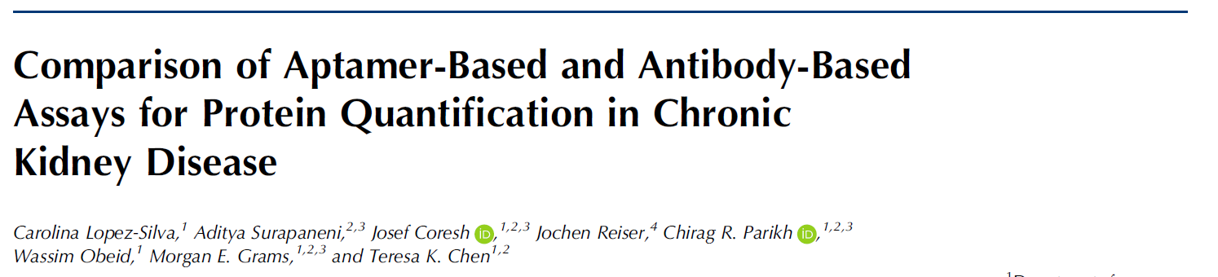
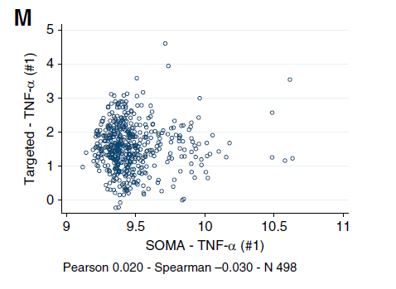
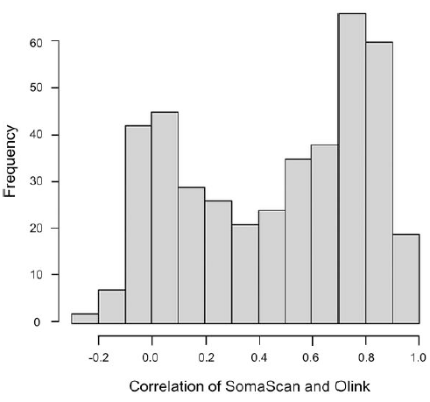
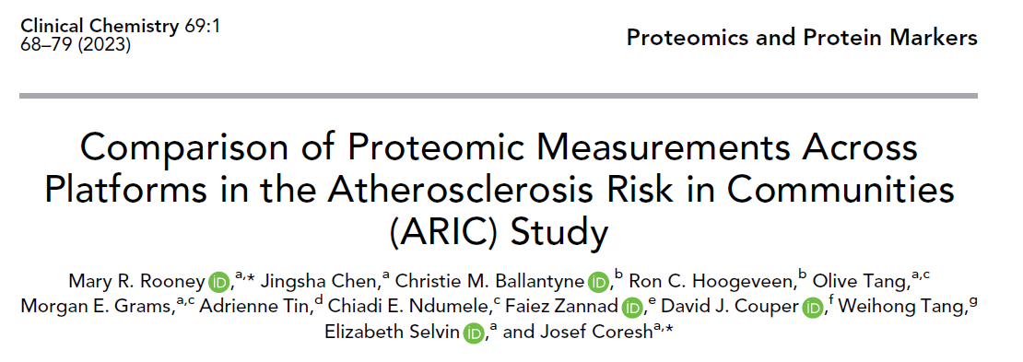
What will happen while using different methods?
Aptamer-based VS immunoassay
Some proteins are not correlated when using these methods
Aptamer-based VS Olink
A substantial number of proteins are not correlated across platforms
Notes:
Comparison of available platforms offers an opportunity for high-throughput assessment.

Slide 15
Conclusion
 | Advantage 😃 | Disadvantage ☹
Mass spectrometry (MS)-based | Results can be compared with databases available online Allows for discovery of new proteins Allows for analysis of post-translational modifications | Methods may result in damage to analyte protein of interest (fragmentation by ionization source) Sensitivity affected by presence of more abundant proteins (albumin)
Aptamer-based | Strong affinity for target proteins even at low concentrations Growing aptamer library increases number of proteins in the proteome | Involving multiple steps (aptamer design, multiple washings etc.,) may introduce human error Limited by the aptamers in libraries Limited ability to detect proteins with post-translational modifications
PEA-based (OLINK) | Minimal cross reactivity Just require a little volume of sample (such as 1ul) | Limited to currently developed panels Limited ability to detect proteins with post-translational modifications Limited by oligonucleotide libraries

Slide 16
1. Overview of different proteomic methods
2. Characteristics of the principal proteomic methods
3. Factors need to consider while selecting
Review

Slide 17
Glossary of some Proteomics Terms
Coverage:
total proportion of protein identified from a complex mixture
Dynamic range:
the largest and smallest abundance of proteins in a mixture
Sensitivity
measure of assay ability to capture analytes with low abundance
Specificity
measure of assay ability to measure particular analyte rather than others

Slide 18
Thanks
Q&A

